Slide 1
SQL Queries Level 1
Peter van Rossum

Slide 2
Topics Level 1: Data Extraction
Basic Relational Database Concepts
Application Setup
All Basics Clauses
Aliases
Table Joins
Aggregates / Distinct Records
Filter Criteria: Text & Numeric Operators

Slide 3
SQL Queries Level 2
Peter van Rossum

Slide 4
Topics Level 2: Advanced Queries
Review
Advanced Table Joins
Views, Top Value
Schema Binding
Sub Queries
Math & Functions
Logic Statements and Variables
Optional Time Permitting: see opt list

Slide 5
SQL Queries Level 3
Peter van Rossum

Slide 6
Topics Level 3: Proper DB Design
Creating Tables and Constraints
Create a Database and Import Tables
Setting Keys and Indexes
Setting Referential Integrity
Batch Processing
Proper Testing Procedures
Create Database Diagrams
Optional Time Permitting: see opt list

Slide 7
SQL Queries Level 4
Peter van Rossum

Slide 8
Topics Level 4: Managing a Database
Transactions
Inserting and Updating Records Manually
Altering DBO Structures
Low Level Security: Schema Binding
High Level Security: Temp Tables
Stored Procedures: Parameters
Stored Procedures: Automation & Triggers
Optional Time Permitting: Conversion Functions

Slide 9
SQL Queries Optional Topics
Peter van Rossum

Slide 10
Topics Level: Optional Topics
Create Transactions
Manipulate Data Manually
Partitions
Temp Tables
Stored Procedures: Parameters
Stored Procedures: Automation & Triggers
Conversion Functions
Join Multiple DBs

Slide 11
Data Cleansing
Peter van Rossum

Slide 12
Data Cleansing Concepts
Analyze data integrity
Cleanse data from common mistakes
Utilize formulas to correct poor data entry
Structure tables optimally for import
Identify potential bad practices
Break text strings into component parts
Extract data from multiple file types
Correct data due to conflicting formats
Use tools such as Optical Character Recognition Programs to strip useful data from challenging sources
Apply Best Practices in database construction and maintenance to preserve data integrity

Slide 13
Data Cleansing Lessons
Identifying Problems
• Poor Data Entry • Redundant Data • Unmatched Data • Incorrect Data Types • Improper Table Structures Exploring Various Tools
• Excel Worksheet Functions & Tools • Excel Visual Basic Procedures • Access and SQL Server Functions • Find and Replace Tools • Using Notepad Interactive Workshops
• Importing and Exporting Across Varying Platforms • Extracting Tables from PDF Files • Writing Cleanup Functions in Excel • Using VBA to Automate Normalization of Table Structures • Understanding and Building Referential Integrity

Slide 14
Basic Coding Information
Clauses, Criteria, Boolean Expressions, Operators, Order of Precedence, Etc.

Slide 15
Main Code Elements
Major Clauses
Additional Clauses
Select (what flds)
From (what tbls)
Where (filter records)
Group By (sort & group)
Having (filter groups)
Order By (sort)
Use (what database)
Inner Join… tbl On tbl.fld = tbl.fld
Left Outer Join… tbl On tbl.fld = tbl.fld
Right Outer Join… tbl On tbl.fld = tbl.fld
Full, Cross, Self, Union, Intersect, Except
With Cube (grand total)
Asc (ascending)
Desc (descending)
Crossed off items are optional

Slide 16
Special Characters
Boolean & Criteria Expressions
= (Equal)
<> (Not Equal)
> (Greater Than)
>= (Greater Than or Equal)
< (Less Than)
<= (Less Than or Equal)
Like (Used with Wildcard)
% or _ (Wild Cards)
Not (Exclude)
Or (Inclusive)
And (Across Fields)
In (Use with Arrays)
Is (Use with Arrays, Null, Not)
Null (Blanks)
Between…And… (Range)
Operators
+ (Plus, Concatenation)
- (Minus)
* (Multiply, Show All Fields)
/ (Divide)
% (Modulo [Remainder] … example: 9 % 2 = 1)
Special Characters
( ) (Used to force Order of Operations, for Clarity, and to Enclose Function Arguments, Arrays and Sub Queries)
[ ] (Encloses a series of several potential characters as an array to search a text string or enclose fld, tbl or db names containing spaces or reserved words)

Slide 17
Logical Operators
ALL | TRUE if all of a set of comparisons are TRUE.
AND | TRUE if both Boolean expressions are TRUE.
ANY | TRUE if any one of a set of comparisons are TRUE.
BETWEEN | TRUE if the operand is within a range.
EXISTS | TRUE if a subquery contains any rows.
IN | TRUE if the operand is equal to one of a list of expressions.
LIKE | TRUE if the operand matches a pattern.
NOT | Reverses the value of any other Boolean operator.
OR | TRUE if either Boolean expression is TRUE.
SOME | TRUE if some of a set of comparisons are TRUE

Slide 18
Order of Precedence
Level | Operators
1 | ~ (Bitwise NOT)
2 | * (Multiply), / (Division), % (Modulo)
3 | + (Positive), - (Negative), + (Add), (+ Concatenate), - (Subtract), & (Bitwise AND), ^ (Bitwise Exclusive OR), | (Bitwise OR)
4 | =, >, <, >=, <=, <>, !=, !>, !< (Comparison operators)
5 | NOT
6 | AND
7 | ALL, ANY, BETWEEN, IN, LIKE, OR, SOME
8 | = (Assignment)
Operators have the precedence levels shown in the preceding table. An operator on higher levels is evaluated before an operator on a lower level. When two operators in an expression have the same operator precedence level, they are evaluated left to right based on their position in the expression.

Slide 19
SQL Data Types
Text, Number, Date, Etc.

Slide 20
String Data Types
Data type | Description | Storage
char(n) | Fixed width character string. Maximum 8,000 characters | Defined width
varchar(n) | Variable width character string. Maximum 8,000 characters | 2 bytes + number of chars
varchar(max) | Variable width character string. Maximum 1,073,741,824 characters | 2 bytes + number of chars
text | Variable width character string. Maximum 2GB of text data | 4 bytes + number of chars
nchar | Fixed width Unicode string. Maximum 4,000 characters | Defined width x 2
nvarchar | Variable width Unicode string. Maximum 4,000 characters
nvarchar(max) | Variable width Unicode string. Maximum 536,870,912 characters
ntext | Variable width Unicode string. Maximum 2GB of text data
bit | Allows 0, 1, or NULL
binary(n) | Fixed width binary string. Maximum 8,000 bytes
varbinary | Variable width binary string. Maximum 8,000 bytes
varbinary(max) | Variable width binary string. Maximum 2GB
image | Variable width binary string. Maximum 2GB

Slide 21
Discussion on String Data Types
TEXT, NTEXT, IMAGE: all those types are scheduled to be removed in a future version of SQL Server - don't use those!
CHAR vs. VARCHAR: CHAR is fixed-length, and it will be padding inputs with spaces to the defined length. Works best for short strings (< 5 characters), e.g. codes, like currency (almost always 3 characters), US status (2 chars) etc. VARCHAR on the other hand works best for longer strings and is only storing as much characters as are inserted/updated. If you define a VARCHAR(200) and only insert Christmas into the field, your field occupies 9 characters (and a little bit of overhead)
NCHAR/NVARCHAR: Unicode versions of the above; always stores 2 bytes per characters, so your field with Christmas in it will store 9 characters and use 18 bytes to do so. Those are needed if you have non-Western-European characters - such as Cyrillic, Arabic, Hebrew, Asian or other alphabets.
VARCHAR(MAX) / NVARCHAR(MAX) are the replacements for TEXT and NTEXT - storing up to 2 GB (2 billion bytes) of data - that's over 300 times the content of Tolstoy's War and Peace - should suffice for the vast majority of cases

Slide 22
Number Data Types
Data type | Description | Storage
tinyint | Allows whole numbers from 0 to 255 | 1 byte
smallint | Allows whole numbers between -32,768 and 32,767 | 2 bytes
int | Allows whole numbers between -2,147,483,648 and 2,147,483,647 | 4 bytes
bigint | Allows whole numbers between -9,223,372,036,854,775,808 and 9,223,372,036,854,775,807 | 8 bytes
decimal(p,s) | Fixed precision and scale numbers. Allows numbers from -10^38 +1 to 10^38 –1. The p parameter indicates the maximum total number of digits that can be stored (both to the left and to the right of the decimal point). p must be a value from 1 to 38. Default is 18. The s parameter indicates the maximum number of digits stored to the right of the decimal point. s must be a value from 0 to p. Default value is 0 | 5-17 bytes

Slide 23
Number Data Types - continued
Data type | Description | Storage
numeric(p,s) | Fixed precision and scale numbers. Allows numbers from -10^38 +1 to 10^38 –1. The p parameter indicates the maximum total number of digits that can be stored (both to the left and to the right of the decimal point). p must be a value from 1 to 38. Default is 18. The s parameter indicates the maximum number of digits stored to the right of the decimal point. s must be a value from 0 to p. Default value is 0 | 5-17 bytes
smallmoney | Monetary data from -214,748.3648 to 214,748.3647 | 4 bytes
money | Monetary data from -922,337,203,685,477.5808 to 922,337,203,685,477.5807 | 8 bytes
float(n) | Floating precision number data from -1.79E + 308 to 1.79E + 308. The n parameter indicates whether the field should hold 4 or 8 bytes. float(24) holds a 4-byte field and float(53) holds an 8-byte field. Default value of n is 53. | 4 or 8 bytes
real | Floating precision number data from -3.40E + 38 to 3.40E + 38 | 4 bytes

Slide 24
Date Data Types
Data type | Description | Storage
datetime | From January 1, 1753 to December 31, 9999 with an accuracy of 3.33 milliseconds | 8 bytes
datetime2 | From January 1, 0001 to December 31, 9999 with an accuracy of 100 nanoseconds | 6-8 bytes
smalldatetime | From January 1, 1900 to June 6, 2079 with an accuracy of 1 minute | 4 bytes
date | Store a date only. From January 1, 0001 to December 31, 9999 | 3 bytes
time | Store a time only to an accuracy of 100 nanoseconds | 3-5 bytes
datetimeoffset | The same as datetime2 with the addition of a time zone offset | 8-10 bytes
timestamp | Stores a unique number that gets updated every time a row gets created or modified. The timestamp value is based upon an internal clock and does not correspond to real time. Each table may have only one timestamp variable

Slide 25
Other Data Types
Data type | Description
sql_variant | Stores up to 8,000 bytes of data of various data types, except text, ntext, and timestamp
uniqueidentifier | Stores a globally unique identifier (GUID)
xml | Stores XML formatted data. Maximum 2GB
cursor | Stores a reference to a cursor used for database operations
table | Stores a result-set for later processing

Slide 26
Student Labs
SQL Level 1

Slide 27
001 Basics / Lab 1
Using 2 tables:
Customers and Slspers (Sales Persons)
Display following fields:
customer number and name
customer city and state
the assigned sales rep's ID
the sales rep's first and last name
show only the records for the California customers
Sort by customer name in descending fashion

Slide 28
001 Basics / Lab 1 Result
select Custnum, Custname, city, state, Customers.repid, fname, lname
from Customers
inner join Slspers on Customers.repid = Slspers.repid
where state = 'CA'
order by custname desc

Slide 29
002 Aliases / Lab 1
From the customers table
count the number of California's and Washington's Customers
Name the field:
“Count of West Coast Customers“
Show the number of customers for both states

Slide 30
002 Aliases / Lab 1 Result
select state, COUNT(custnum) as 'Count of West
Coast Customers'
from Customers
where state = 'CA' or state = 'WA'
group by state

Slide 31
003 Joins / Lab 1
See if there are any sales for any of the books in the Obsolete_Titles table in the current database
Which are the books that have not sold?

Slide 32
003 Joins / Lab 1 Result
Select *
From
Obsolete_Titles
Inner Join
Sales
on
Sales.Partnum = Obsolete_Titles.Partnum

Slide 33
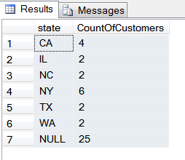
004 Aggregates / Lab 1
Analyze what is wrong with the Grand Total of this query
Discuss alternate solutions and test them

Slide 34
004 Aggregates / Lab 2
What’s wrong with this query’s results?
Analyze results, explain how it can be corrected
state | ordnum | SumQty | MaxQty | MinQty | AvgQty | CountQty
CA | 105 | 150 | 150 | 150 | 150 | 1
CA | 109 | 250 | 250 | 250 | 250 | 1
CA | 112 | 120 | 120 | 120 | 120 | 1
CA | 115 | 190 | 190 | 190 | 190 | 1
CA | 116 | 100 | 100 | 100 | 100 | 1
CA | 117 | 200 | 200 | 200 | 200 | 1
CA | 118 | 240 | 240 | 240 | 240 | 1
CA | 120 | 180 | 180 | 180 | 180 | 1
CA | 132 | 400 | 400 | 400 | 400 | 1
CA | 133 | 130 | 130 | 130 | 130 | 1
CA | 150 | 370 | 370 | 370 | 370 | 1

Slide 35
004 Aggregates / Lab 3
Create a query that Summarizes the customers rather than the Orders.
Custname | Ordnum | Customer_Total
AFR Tours | 119 | 6900
AFR Tours | 122 | 2379
AFR Tours | 158 | 5050
AFR Tours | 169 | 17250
Dazzle Gardens | 109 | 6250
Dazzle Gardens | 112 | 3000
Dazzle Gardens | 115 | 3895
Dazzle Gardens | 116 | 2500

Slide 36
004 Aggregates / Lab 3 Results
select
Custname, Sum(Qty*Slprice) CustTotal
from
Customers c
Inner join Sales s on s.custnum = c.custnum
inner join Titles t on s.partnum =t.partnum
group by
c.custnum, custname
order by custname

Slide 37
005 Numeric Criteria / Lab 1
How much commission did each Sales Rep make on each order?
Only show records for those who earned $500 or more.
Display all relevant fields.
Which tables contain the required fields?

Slide 38
005 Num. Criteria / Lab 1 Result
select
Lname as SalesRep,
s.repid as ID#,
commrate as CommRate,
Ordnum as Ord#,
qty*slprice as OrderTotal,
commrate*qty*slprice as Commission
from
slspers as r, sales as s, titles as t

Slide 39
005 Num. Crit. / Lab 1 – con’t
where
r.repid = s.repid and s.partnum = t.partnum
and commrate*qty*slprice >= 500
Order by
lname desc

Slide 40

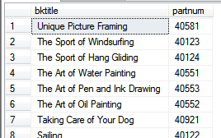
006 Text Criteria / Lab 1
The 2nd query has the following 11 items in it and we wish to see all of them
What is wrong with the 1st query result?
How do we fix it?

Slide 41
006 Lab 1 Result
select bktitle, partnum
from titles
where rtrim(bktitle) like '%g‘
order by bktitle desc
The right trim function removes blank spaces from the right side of a field

Slide 42
006 Text Criteria, Operators / Lab 2
The titles table contains a "learning" series of language books.
We wish to display all of them except the book that deals with "Learning to Crochet".
We also need to display the price field and sort by title.

Slide 43
006 Lab 2 Result
select
bktitle as Title,
partnum as Book_ID,
slprice as Price
From
titles
where
bktitle like 'learning%' and bktitle not like '%crochet%'
order by title

Slide 44
Student Labs
SQL Level 2

Slide 45
003 Joins / Lab 2
Show the inequalities between the Customers, Sales and Titles tables
Display all relevant fields: ID Numbers, Names, etc
Show all IDs from the Sales Table but also from their respective tables
Interpret the results i.e.:
Which are the books that have not sold?
Who are the customers that have not bought anything?
Which orders are written for non existent customers or books?

Slide 46
003 Joins / Lab 2 Result
select c.custnum, s.Custnum, custname, ordnum, s.partnum, t.partnum, bktitle
from sales as s
full outer join Customers as c on c.custnum = s.custnum
full outer join titles as t on t.partnum = s.partnum

Slide 47
007 Math, Functions, Logicals / Lab 1
How can we achieve a greater degrees of accuracy on lesson 6 (previous query)?
Title | Years in Print
When Birds Do not Fly | 17
Hammer and Nails | 21
Taking a Walk Alone | 19
Learning to Diet | 21
Wonderful Thoughts and Marvellous Dreams | 24
Clear Cupboards | 19
Y2K Why Worry? | 18

Slide 48
007 Lab 1 Result
select
bktitle as Title,
datediff(day, pubdate, getdate()) / 365.25
as 'Years in Print'
from obsolete_titles

Slide 49
007 Math, Functions, Logicals / Lab 2
Create email addresses for all employees along side their ID numbers - result should look like the following example:
r.gibson@ogcbooks.com
The result should be in all lower case.

Slide 50
007 Lab 2 Result
select
repid as Emp#,
rtrim(lname)+', '+left(fname,1)
as Full_Name,
lower(left(fname,1)+'.'+rtrim(lname)+
'@ogcbooks.com') as eMail
from slspers

Slide 51
007 Math, Functions, Logicals / Lab 3
Using the If function & And operator in combination, test book prices and break them into the following 'Price_Range' categories:
'$0 to $20'
'$20 to $30'
'$30 to $40'
'$40 to $50'
'$50 to $100'
If function is also known as a 'Case, When, Then' statement

Slide 52
007 Lab 3 Result
SELECT
partnum as Book_ID, bktitle as Book, slprice as Price,
CASE
WHEN slprice < 20 THEN '$0 to $20'
WHEN slprice >= 20 and slprice < 30 THEN '$20 to $30'
WHEN slprice >= 30 and slprice < 40 THEN '$30 to $40'
WHEN slprice >= 40 and slprice < 50 THEN '$40 to $50'
ELSE '$50 to $100'
END as Price_Range
FROM
Titles
ORDER BY
Price_Range, Book asc

Slide 53
008 Format Conversion Functions / Lab 1
Summarize all order totals by customers
Since this is only for analysis purposes we do not need to see decimals
Currency symbols and commas need to be shown

Slide 54
008 Lab 1 Result
select
c.Custnum as CustID,
Custname as Customer,
'$'+parsename(convert(nvarchar,round
(sum(qty*slprice),0),1),2)
as 'Customer Totals'
from Customers as c, Sales as s, Titles as t
where c.custnum = s.custnum
and t.partnum = s.partnum
group by c.Custnum, custname

Slide 55
002 Sub Qrys / Lesson 1 Lab 1
Find sales reps with greater than average commission rates
What tables are needed?
What fields are needed?
What goes in the sub query?

Slide 56
002 Lesson 1 Lab 1 Result
select repid, fname, lname, commrate
from Slspers
where commrate
> (select AVG(commrate) from Slspers)

Slide 57
002 Sub Qrys / Lesson 2 Lab 2
Find sales reps that are not performing
How many and which tables are needed?
What fields are needed?
What goes in the sub query?

Slide 58
002 Lesson 2 Lab 2 Result
select Slspers.repid, fname, lname
from Slspers
where Slspers.repid
not in (select Sales.repid from Sales)

Slide 59
002 Sub Qrys / Lesson 4 Lab 3
Create same result as in the previous query (not previous lab) with an inner join query
Hint - use the distinct qualifier

Slide 60
002 Lesson 4 Lab 3 Result
select distinct c.custnum
from Customers as c
inner join Sales as s on c.custnum = s.custnum
where qty < 400

Slide 61
002 Sub Qrys / Lesson 5 Lab 4
Using the inner join method versus sub qry method, create same results as in Lesson 5

Slide 62
002 Lesson 5 Lab 4 Result
select distinct(c.custnum), Custname, address,
city, max(slprice) as BkPrice
from Customers as c
inner join Sales as s on c.custnum = s.custnum
inner join Titles as t on s.partnum = t.partnum
group by c.custnum, custname, address, city
having MAX(slprice)>=35
order by custname asc

Slide 63
002 Lesson 5 Lab 5 Optional
Create report that shows Order Total for each individual order
Give the percent of the grand total that each individual order represents
Display all relevant fields
Customer
Order number and Name of Book Ordered
Order value
Grand total
% of Grand Total

Slide 64
002 Lesson 5 Lab 5 Result
Select
Custname as Customer,
Ordnum 'Ord #',
Bktitle as Book,
Qty*slprice as 'Ord Total',
Qty*slprice/
(Select sum(Qty*slprice)
From Sales as s,Titles as t
Where t.partnum = s.partnum) as '% Of Total',
Continued on next slide…

Slide 65
002 Lesson 5 Lab 5 Result - continued
(Select sum(Qty*slprice)
From Sales as s, Titles as t
where t.partnum = s.partnum) as 'Grand Total'
From
Customers as c
join Sales as s on s.custnum = c.custnum
join Titles as t on t.partnum = s.partnum
Order By custname, Ordnum

Slide 66
005 Views Lab 1
This is required for all following Labs including Stored Procedures
Create an 'AllTablesBase' View of main tables (Customers, Sales, Titles, Slspers)
Show all fields (but no duplicate fields)
Show a total value per order calculation
Show all records from all tables referenced in the view

Slide 67
005 Lab 1 Result
CREATE VIEW AllTablesBase AS
SELECT
c.*,
s.ordnum, sldate, qty,
t.*,
r.lname, fname, commrate,
qty*slprice as OrderTotal
FROM
Customers AS c Full OUTER JOIN
Sales AS s ON s.custnum = c.custnum Full OUTER JOIN
Titles AS t ON t.partnum = s.partnum Full OUTER JOIN
Slspers AS r ON r.repid = c.repid

Slide 68
005 Views Lab 2
Part 1:
Create a View 'GrandTotalAllOrders' based on the view “AllTablesBase” to show the grand total of all the orders
Part 2:
Create a Select query based on the “GrandTotalAllOrders” and the “AllTablesBase” views to show the percent of total per each order

Slide 69
005 Lab 2 Result
Part 1
create view GrandTotalAllOrders as
select sum(orderTotal) as GrandTotal
from alltablesbase
Part 2
select State, sum(Ordertotal) as TotalsByState, GrandTotal, round(sum(ordertotal),2)/grandtotal as '%ofTotal'
from dbo.alltablesbase - - this is a view
cross join dbo.GrandTotalAllOrders - - this is a view
group by state, Grandtotal
having state is not null
order by TotalsByState desc

Slide 70
005 Views Lab 3
Create and use a view 'CustomerSummaries' of summarized data from another view 'AllTablesBase' to evaluate the Customer Status
Requires 005 Lab 1

Slide 71
005 Lab 3 Result
Step 1:
create view CustomerSummaries as
select custname, sum(ordertotal) as sumOrdersByCust
from alltablesbase - - this is a view
group by custname
having SUM(ordertotal) is not null
Continued on next slide…

Slide 72
005 Lab 3 Result - continued
Step 2:
select custname, sumOrdersByCust ,
case
when sumOrdersByCust >= 50000 then
'gold star member'
when sumOrdersByCust >= 20000 then
'silver star member'
when sumOrdersByCust >= 10000 then
'bronze star member'
else 'valued customer'
end as CustStatus
from dbo.customersummaries - - this is a view
order by sumOrdersByCust desc

Slide 73
Student Labs
Needs Updating
SQL Level 3

Slide 74
Import / Lab 1
Import Data from the Excel workbook InvestConsul.xlsx - Range Named “acctmngrs” into the “InvestmentConsultantsInc” database
Verify

Slide 75
Import / Lab 2
Import Data from the Access Database NorthWindDistributers.mdb into NorthWindLev3
All tables without data only
Rename tables to remove the word ‘copy’
Import Data from the Access Database NorthWindDistributers.mdb into NW_Lev3
All tables with data only

Slide 76
Import / Lab 3
Migrate Records from NWD_Lev3 to NorthWindLev3

Slide 77
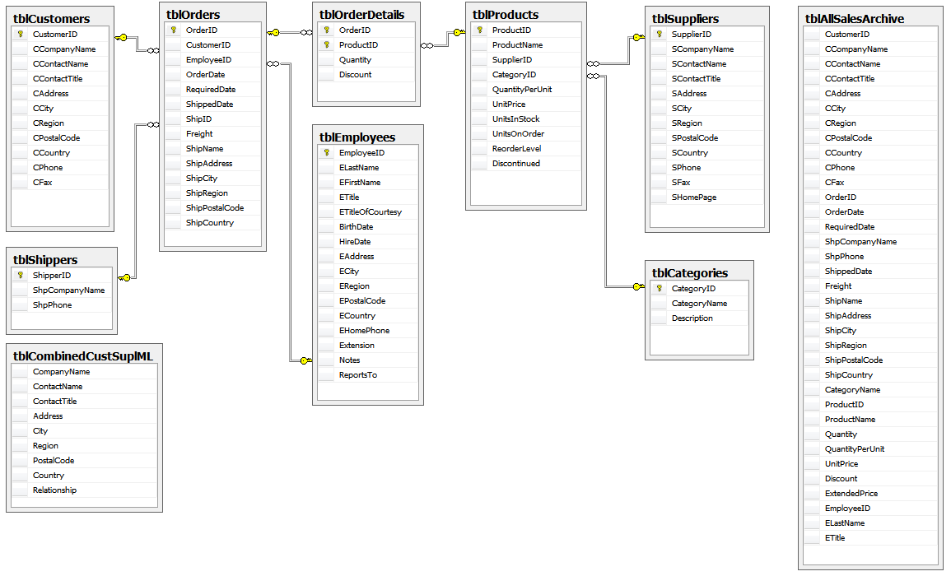
Database Diagrams / Lab 1

Slide 78
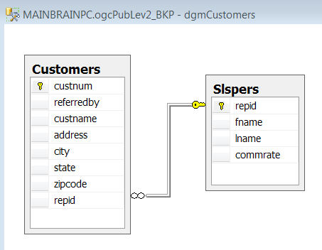
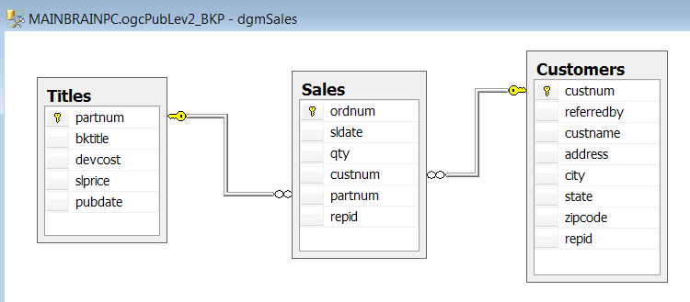
Database Diagrams / Lab 1

Slide 79
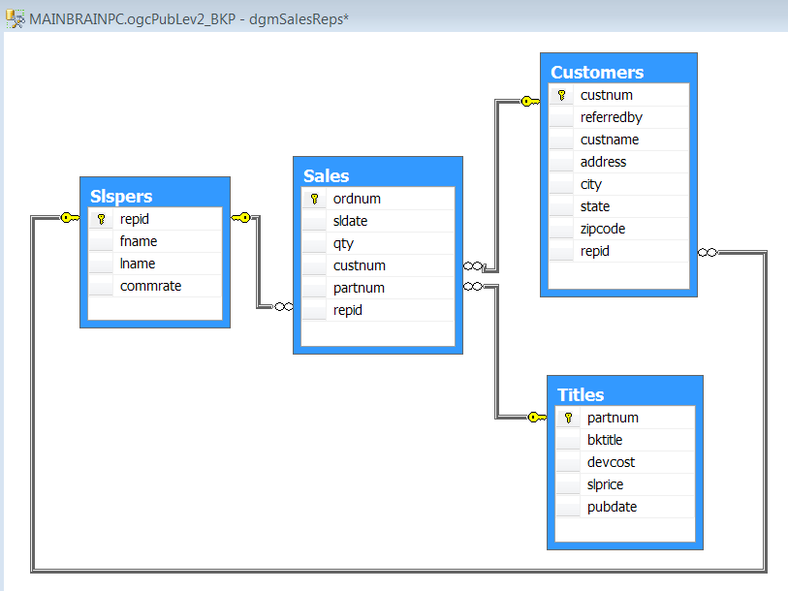
Database Diagrams / Lab 1

Slide 80
Conversion / Lab 1
Summarize all order totals by customers. Since this is only for analysis purposes we wish to only see zero decimal values. Currency symbols and commas need to be shown.

Slide 81
Calculations/ Lab 1
Group previous query by pricing range and count the books in each range

Slide 82
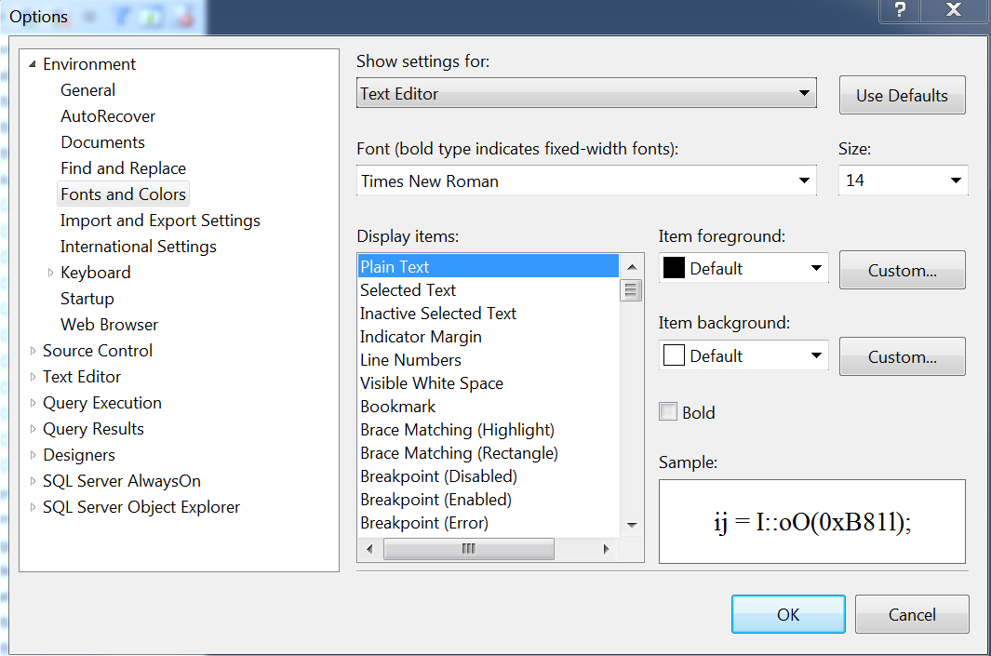

Slide 83
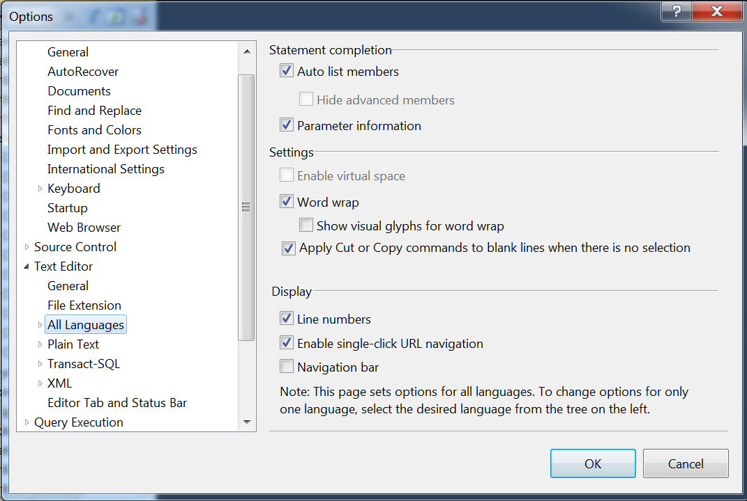

Slide 84
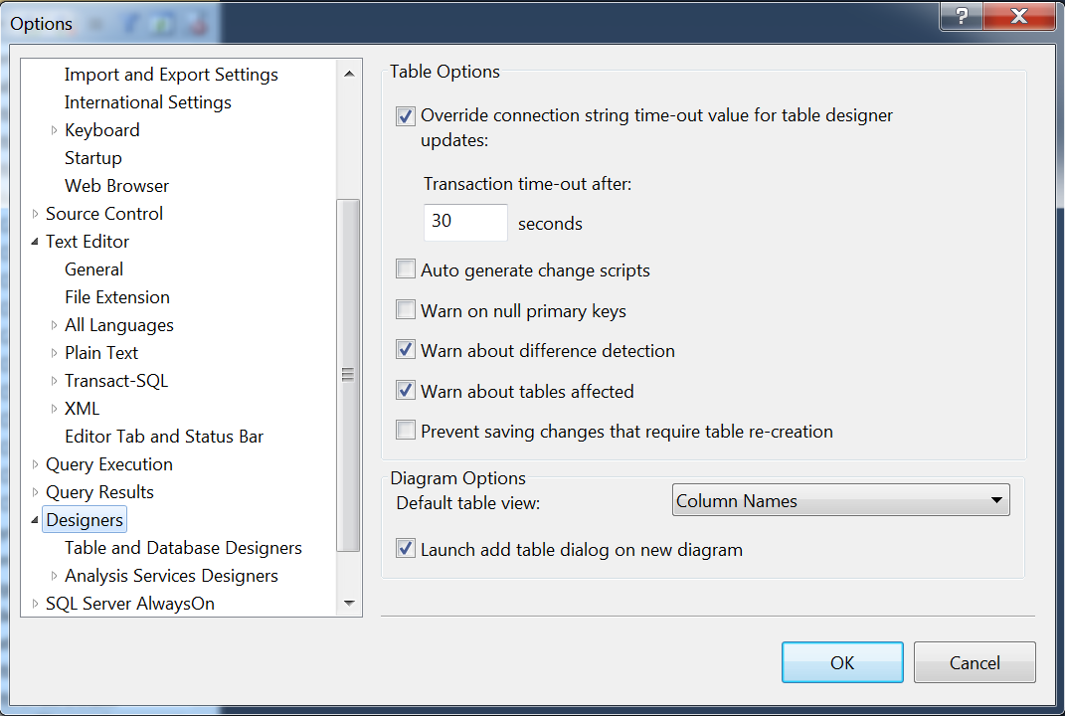

Slide 85
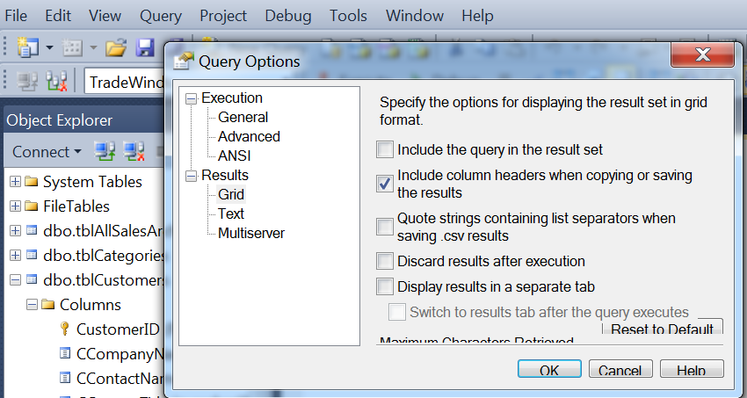

Slide 86
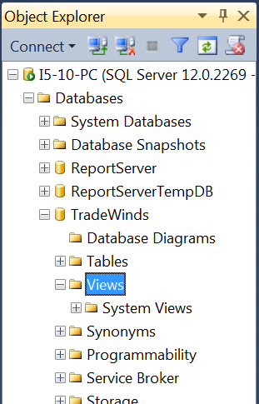
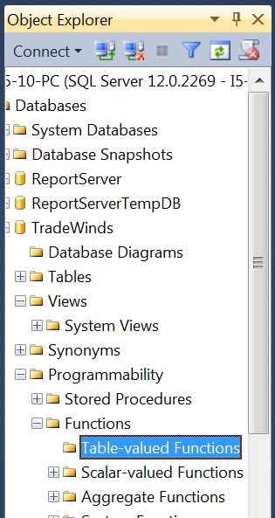

Slide 87
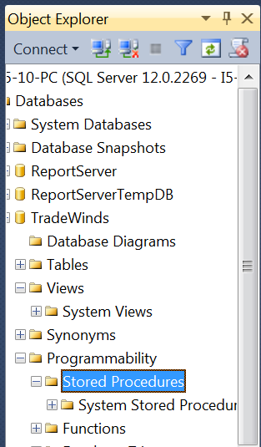

Slide 88
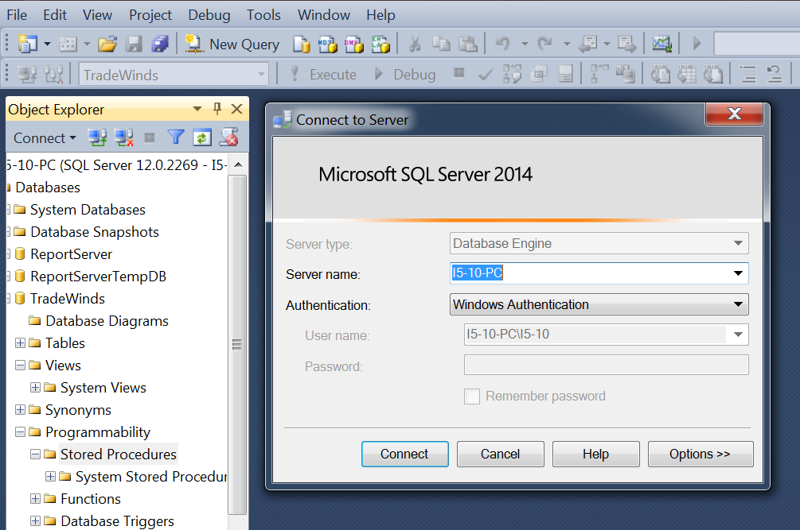

Slide 89
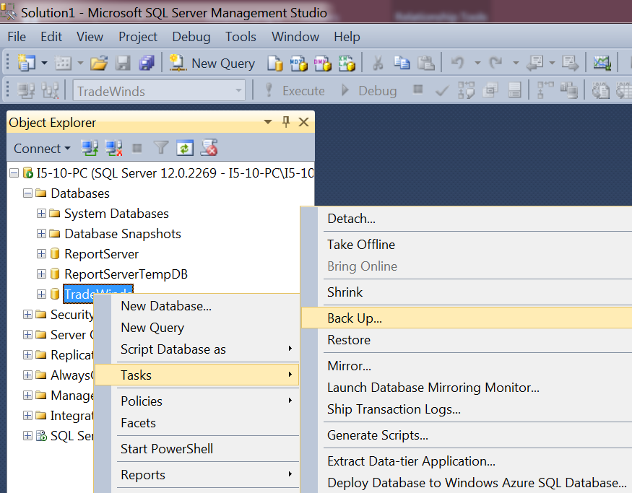
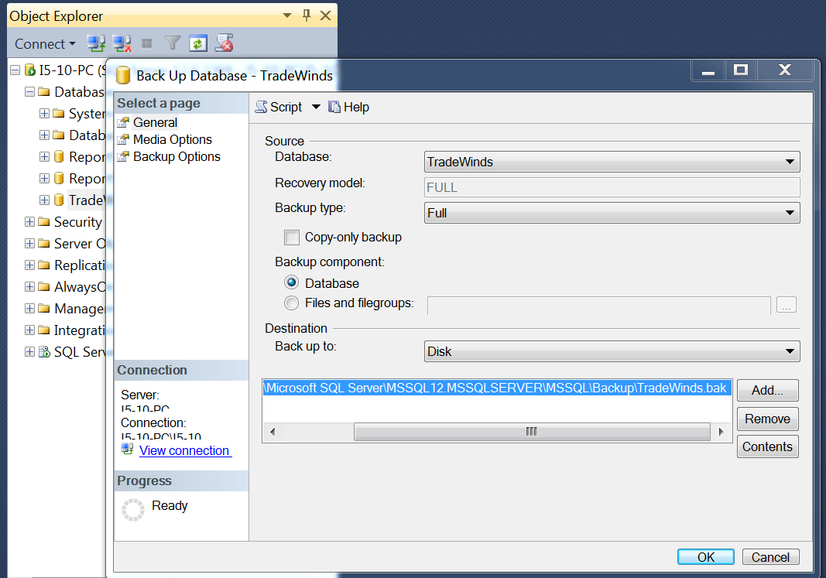

Slide 90
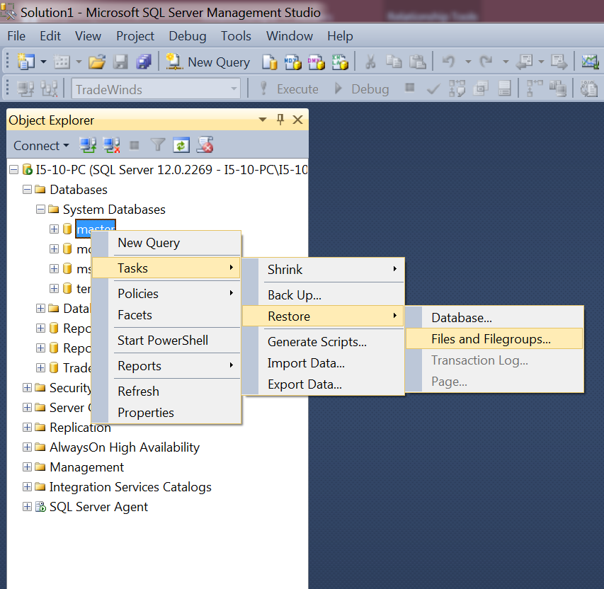

Slide 91
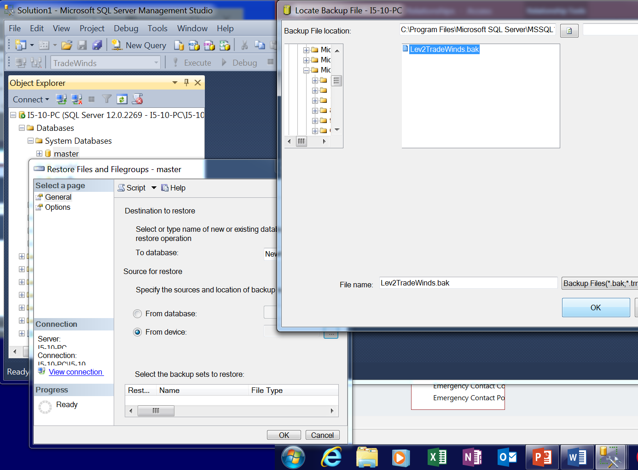
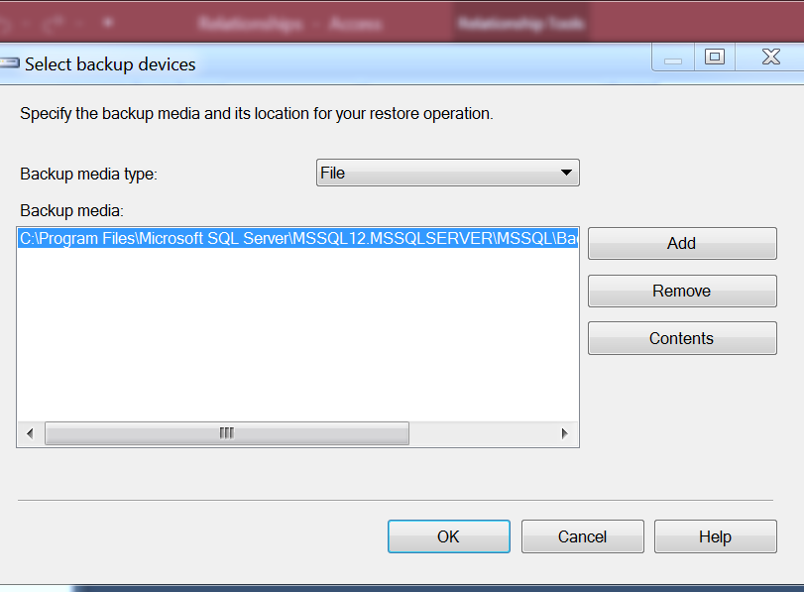

Slide 92
